Slide 1

Harsha Simhadri* (Organizer for Track T1/T2), George Williams§ (Organizer for Track T3), Martin Aumüller¤, Matthijs Douze†, Ravishankar Krishnaswamy ^{*+}, Artem Babenko‡, Dmitry Baranchuk‡, Qi Chen*, Lucas Hosseini†, Gopal Srinivasa*, Suhas Jayaram Subramanya#, Jingdong Wang^ *Microsoft Research, §GSI Technology, ¤IT University of Copenhagen, †Facebook AI Research, ‡Yandex Labs, #Carnegie Mellon University, ⁺IIT Madras, ^Baidu
Billion-Scale Approximate Nearest Neighbor Search Challenge
https://big-ann-benchmarks.com/
[Thanks to Microsoft Research for generous support including Azure credits for participants and organizers]
Notes:
Hi, I am harsha simhadri, and I will give an overview of the billion-scale ANNS challenge. The goal of this competition is encourage the development and understanding of indexing algorithms for ANNS that work at large scales representative of real-world use cases. The organization of this competition is a joint effort between researchers from several researchers from industry and academia. I want to thank for George for organizing the specialized hardware track, Martin for designing the evaluation framework, Matthijs for contributing baselines for tracks T1 and T3 as well as datasets, Ravi for providing baseline for track T2, and Artem, Dmitry, QI, Lucas for providing datasets and Gopal, Suhas and Jingdong for help with organizing. I also want to thank Microsoft Research for generous support in origanizing this competition including Azure credits for participants and organizers.

Slide 2

ANNS: Problem and Importance
Search/recommendation using high-dimensional embeddings/encodings of objects.
Obj
Doc
Embed
Doc
Doc
Doc
Doc
Doc
Doc
Embed
Doc
Query
Doc
Database
N = 10⁶ or 10⁹ or 10¹² points
K=4 nearest neighbors
R^{d} d~100
Exact retrieval might need exhaustive scan, settle for approximate retrieval.
Measure Recall: the fraction of output candidates that are true top-k nearest neighbors
Notes:
So why ANNS? As you know, deep-learning based embeddings have become commonplace and powerful for many tasks. They are increasingly used at scale in search and recommendation applications like web or enterprise search and product recommendations.
In the framework of deep learning based search, ANNS is a critical component that serves as the first retrieval layer. Documents in the database, which could contain trillions of URLs or images, are encoded into a high dimensional space with hundreds of dimensions. Queries to the index are also encoded into the same space.
The first step in finding the documents relevant to the query is to retrieve the top-k geometrically nearest neighbors to the query.
As you know, exact retrieval of nearest neighbors in hundreds of dimensions is hard and effectively requires a linear scan through the database.
Therefore, we settle for approximate retrieval.
We measure the quality of the results using a statistic called recall which measures the fraction of output candidates that are in fact the true top-k nearest neighbors.
There is a tension between the accuracy or recall of an indexing algorithm and the recall it provides. The goals is to design algorithms that can push the recall vs query throughput curves higher.

Slide 3
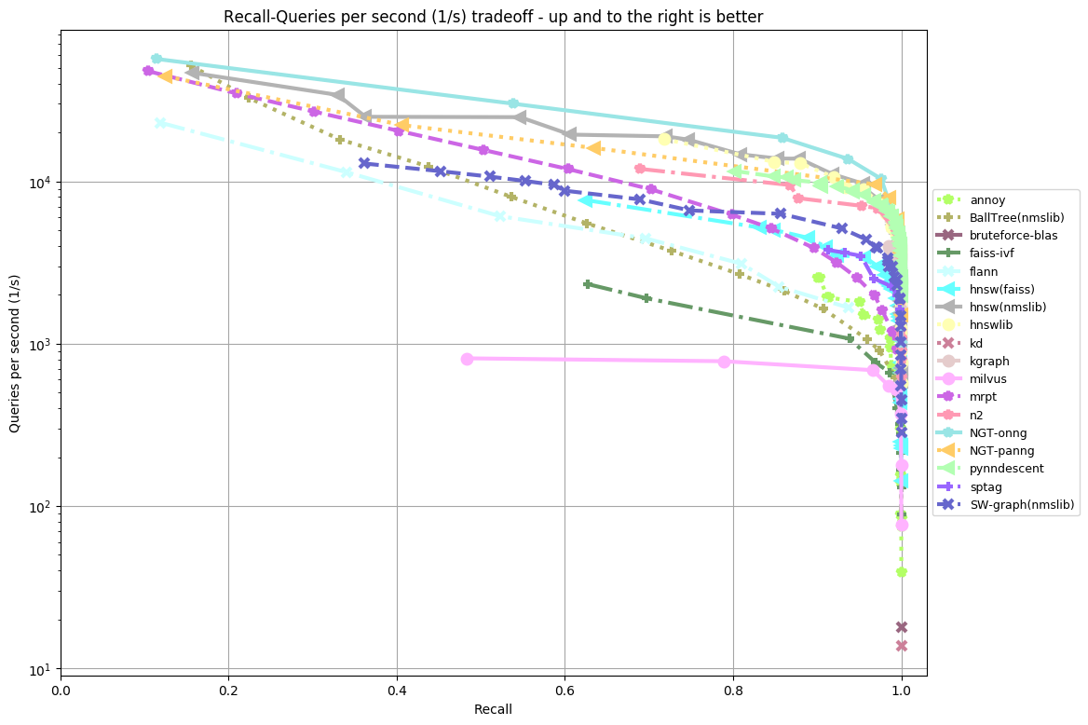
Long history of work.. In academia and industry
ann-benchmarks.com
SIFT Image descriptors
1M points, 128 dimensions, L2 distance
Many classes of algorithms
Trees: k-d trees, Ball trees, cover trees,…
Clustering: IVF (FAISS)…
Hashing: LSH, Data dependent hashing, Asymmetric hashing,…
Graph based: NSW, HNSW, NSG, NGT, SPTAG, NGT, ONNG,…
Compression based
PQ, OPQ,.. For L2 metric
SCANN for inner product
Domain specific:
Sparse high-dimensional
Geospatial
Notes:
There is a rich history of work on this problem. There are several classes of algorithms based on trees, clustering, and hashing. Hashing based methods are widely appreciated as its possible to prove bounds on their recall as a function of index size and search complexity. However, since 2015, graph based algorithms have emerged as the empirical SoTA for ANNS and have been widely adopted in industry. Further, there are other research directions in this problem such as compressing the vectors that can reduce the footprint of many classes of indices.
There is an active community of researchers benchmarking the latest implementation of these algorithms. Here is a plots from ann-benchmarks.com that compares the recall vs query throughput of various algorithms on a 1 million point image descriptor dataset.

Slide 4
Competition: What and why?
ANNS increasingly used in scenarios with 10⁹ – 10¹² or more objects to index, e.g.
Web search, Recommend Ads, Enterprise/email search, Search large image databases
Most algorithms are evaluated on million-scale datasets; Competition focuses on indexing 1 billion points per machine.
Embeddings for a billion points can be 100GB (100 dim x int8) – 1TB (256dim x float)
Storing embeddings + index in memory can be expensive. Need to find alternative.
Standardized hardware (track T1/T2) and Specialized hardware (track T3)
Notes:
This brings us to the competition. As you recall from previous slide, most current evaluations like the one at ann-benchmarks.com focus on datasets that are about a million scale. But there increasingly scenarios where embedding based retrieval techniques are being applied to datasets with billions or trillions of objects and more. For example, enabling web search via deep learning could require indices spanning hundreds of billions to trillions of vectors. Similar, searching large image databases for, say tagging certain content, could require indexing several billions of images and so on.
Therefore, we aim to encourage the development of algorithms that can index a billion points per machine. Larger indices can be sharded across several machines, with say a billion points per machine, and are not directly studied here. One of the reason why many of the current algorithms may not be efficient at billion scale is that they use in-memory data structures for answering ANNS queries. The embeddings for billion points themselves might be 100GB (for 100xint8) to 1TB (256dxfloat). It is not very cost effective to store such large dataset and index over them, in memory. Further, there is the question of whether the index is efficient at searching from a billion entries. While there has Recently been research on algorithms that work with billion-scale datasets, we think there is a lot more room for development and understanding here. The competition is a means to track the development of such algorithms and comparatively study them.
Even within this setting, there is the question of hardware. What algorithms can work on standard hardware, such as generic workstations or commond cloud virtual machines. And what algorithms can take advantage of the specialized hardware like accelerators and new memoery technologies. Therefore, we split the competition into separate tracks. Before we get into the hardware tracks, I want to give a brief overview of the datasets.

Slide 5
Six Billion-scale Datasets from INRIA/IRISA, Facebook, Microsoft, Yandex
Dataset | Source | Size | Encoder/Task | Other notes
BIGANN-1B | CNRS/IRISA http://corpus-texmex.irisa.fr/ | 128 dims uint8 L2 | SIFT descriptors for image similarity
SSNPP-1B* | Facebook | 256 dims uint8 L2 | SimSearchNet++ image encoder | Range search
SpaceV-1B* | Microsoft https://github.com/microsoft/SPTAG/tree/master/datasets/SPACEV1B | 100 dims int8 L2 | Docs and queries encoded by Microsoft SpaceV Superior model to capture generic intent representation.
Turing-ANNS-1B* | Microsoft Turing | 100 dims float L2 | Bing queries encoded by Turing AGI v5 encoder.
Text2Image-1B* | Yandex https://research.yandex.com/datasets/biganns | 200 dims float Inner-product | Images encoded by Se-ResNext-101 model, queries are text encoded by a variant of DSSM | Cross-modal; Query distribution different from index set
DEEP-1B | Yandex https://www.cv-foundation.org/openaccess/content_cvpr_2016/app/S09-38.pdf | 96 dims float L2 | GoogLeNet pretrained for Imagenet classification task + PCA + l2 normalized
[ * new datasets released for the competition]
Notes:
Thanks to researchers from different organizations, we have compiled a preliminary list of 6 billion scale datasets for benchmarking the algorithms. They vary in terms of the dimension and the prevision of the embeddings, the model that generated them, the application they arise in, and the domain they belong to, and in a few other ways I will high light here.
The first, BIGANN-1B, is a dataset which has existed for 10 years and is commonly used for benchmarking in many of the billion scale indexing algorithms. It constists of SIFT image descriptors for 1 billion images that encode image similarity. It is 128 dimensional and has 8 bits of precision per coordinate.
The second, SSN++-1B is a newly released dataset from facebook consisting of higher dimensional encodings compression to 256 bytes using PCA. The encoder is the simsearchnet++ model and the application is to enable tagging of offensive content on Facebook platform. This is different from the other datasets in that it uses range search as opposed to k-nearest neighbors. As in, it asks for all points within a radius of the querys embeddings.
The third and the fourth datasets are newly released by Microsoft and are aimed at capuring generic intent representation in web text. The first of the two, spaceV consist of documents and queries encoded by Microsoft SpaceV superior model and is 100 bytes per emebding. The second of the two, release by Microsoft Turing team, consist of Bing queries encoded by Microsoft Turing AGI v5 model and aims to relate similar web queries.
The fifth, text2image is a newly release dataset from Yandex. It is different from the others in that it uses max inner-product search as opposed to L2 metric. It is also the largest dataset at 800GB. further, it is a cross modal dataset where the quey vectors are text queries encoded with a variant of DSSM, while the indexed set consists of images encoded by Se-ResNext-101 model. As a result, the distribution of the queries is different from the base set, and this dataset is particularly hard for most ANNS algorithms including the baselines included in the competition. To help further algorithm development for out of distribution queries, Yandex researchers have also release 50 million sample query vectors.
Finally, the sixth dataset is a DEEP-1B released earlier and consists of 96 dimensional floating point image descriptors encoded using the final FC layer of Googlenet model pretrained for imagenet classification and then compressed using PCA and L2 normalized.

Slide 6
Track 1: Standard hardware w/limited DRAM
Limit DRAM available for the data + index to 64GB
Smaller than the dataset (100GB-1TB).
Machine: Azure F32sv2 with 32 vCPUs, 64GB RAM
Index construction limited to 128GB DRAM and 4 days
Machine: Azure F64sv2 with 64 vCPUs, 128GB RAM
Considerations:
How well can we compress the points without perturbing the distances between them?
Extremely low over-head indices
Metrics: Recall@10 for the setting with >10K Queries/sec throughput on 32 vCPUs
Notes:
There are three tracks in this competition. The first two are based on standard hardware which correspond to common cloud virtual machine configurations. The third is an open-to-all track where any choice of hardware including custom silicon can be used.
The first of the hardware tracks is based on machines with limited memory. We pick a machine with 64GB DRAM which is typical of servers and workstations and expect the emebddings, or rather a compressed representation of the embeddings, as well as the index to fit with in this. The compute is normal CPUs and doesnot include any accelerators. Specifically, we use the Azure F32sv2 VM with 32 cirtual CPUs and 64GB RAM. We also limit the time for index construction to 4 days on a 64 vCPU Azure F64sv2 machine with 128 GB RAM.
Note that this is smaller than the size of all 6 datasets, so compressing them is key. The question, how effectively can you compress the data without perturbing the distances between the index points and the relative order of nearest neighbors. Since the compression is lossy, in this track, one can not expect any algorithm to get close to 100% recall since the relative ordering of neighbors around most points is perturbed by the compression scheme. Further it is important to use extremely low overhead indices due to the limited space, and as a result, more compute is expected per query.
The metric we measure here is recall@10 vs the query throughput. Specifically, for each algorithm we sweep across different hyperparameter configurations and report the best recall@10 for those runs that achieve atleast 10K QPS on the 32 virtual cores.

Slide 7
Track 1: Baseline FAISS on CPU
Compression using Product Quantization (PQ)-based techniques
Index based on clustering
Centroid
Vector
Cluster boundary
[https://github.com/facebookresearch/faiss]
Notes:
The baseline for this track comes from the popular FAISS suite of algorithms. The compression of points is achieved using product quantization and related techniques. The compression typically reduces each vector in the index set to about 32 bytes, so that the billion-point dataset is about 32GB.
The index is based on clustering and inverted index techniques. To take a simplistic view of how this works– we might construct about sqrt(n) clusters over the n points in the index (n being 1B here) using k-means objective, say using k-means ++ initialization and Lloyds iteration. Then the index consists of the centroids of the clusters and each point in the index assigned to the nearest cluster. To answer a query, we compare it to all the centroids, say find the 100 nearest centroids, and expand the clusters and compare the query to all the points in these 100 clusters. Note the index storage overhead is very small, consisting of just the centroids and a list of points assigned to the centroids. This is particularly useful in adapting to limited memory resources.
Of course, the parameters including the number of clusters, the number of clusters considered per query need to be tuned. And the design, including the compression and the index, itself can be more sophisticated as is the case with variatns within the FAISS index.

Slide 8
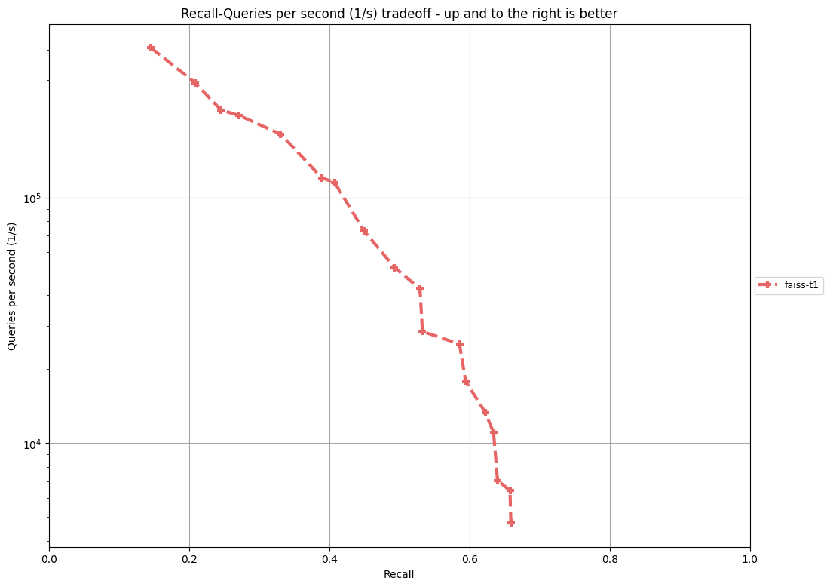
Track 1: Baseline FAISS on CPU
Machine: Azure F32sv2
32 vCPUs, 64GB RAM
Dataset | Recall @10/AP for >10K QPS
bigann-1B | 0.634510
deep-1B | 0.650280
msspacev-1B | 0.728861
msturing-1B | 0.703611
ssnpp-1B | 0.753780
text2image-1B | 0.069275
Queries/second
Recall asymptote due to irreversible loss of precision from compression
Recall@10 on bigann-1B
Notes:
Here is an example of the recall vs query throughput performance of the baseline on the BIGANN-1B dataset on the competition machine. As expected, the throughput drops as the recall increases. However, you can see the recall improvements tapers off and hits an asymptote. This is expected as the compression is lossy and no matter how compute is used for querying, the relative ordering of points in a neighborhood is irreversibly lost due to compression. So we do not expect recall close to 100 in this track. A technique that improves the compression scheme would push the asymptote further out towards 100%. A technique that makes the index look up more efficient would make the curve steeper.
For obtaining a single point of measurement, we use a cutoff of 10K QPS in the competition and record the best recall@10 (or AP for SSN++) in a configuration which proives at least 10K QPS. In the case of BIGANN dataset, this happens to be about 0.634. The table here lists the recall@10 for 10KQPS for all the other datasets as well. As you can see the text2image data is particularly hard due to the cross-modal nature.

Slide 9
Track 2: Limited memory + inexpensive SSD
Limit DRAM to 64GB + 1TB Solid State-Drive
Azure L8sv2 with 8 vCPUs, 64GB RAM, local NVMe SSD
Considerations:
Can store small amount of data in-memory
Can store index and full-precision data on SSD, but index should be searchable with small number of I/Os per query.
Index construction limited to 128GB DRAM and 4 days
Machine: Azure F64sv2 with 64 vCPUs, 128GB RAM + 4TB disk space.
Metrics: recall@10 for the setting with >1500 Queries/sec on 8 vCPUs
Notes:
In track 2, which is another standard hardware track, we augment the same amount of limited DRAM as in track 1 (64GB) with 1TB of local SSD. Sepcifiall, we use the 8 cirtual core Azure Ls8v2 machine with a local SSD for search. As you know, SSD are about 10x less expensive and power hungry compared to DRAM, so the net incremental cost of this addition is very low. However, this allows us far more space which could be used to store the full precision vectors in the index, which in turn allows indices to asymptote to 100% recall. Further, the larger space can be used to potentially store a more intricate index data structures which are much more CPU efficient like graph indices.
Since SSDs can support a limited number of random read operations per second, In order for an indexing algorithm to excel in this track, it needs to use an efficient data structure on the SSD that can answer queries to as few random I/Os as possible. As part of this, the algorithm also needs to carefully manage what is stored in-memory.
Just as in the case of track 1, we limit the index construction to use a machine with 128GB DRAM and 64 cores and a time limit of 4 days.
And the metrics are similar to track 1. Except that we measure recall@10 for the setting that achievs atleast 1500 QPS on 8 virtual CPUs (compared to 32 vCPUs in track 1)/

Slide 10
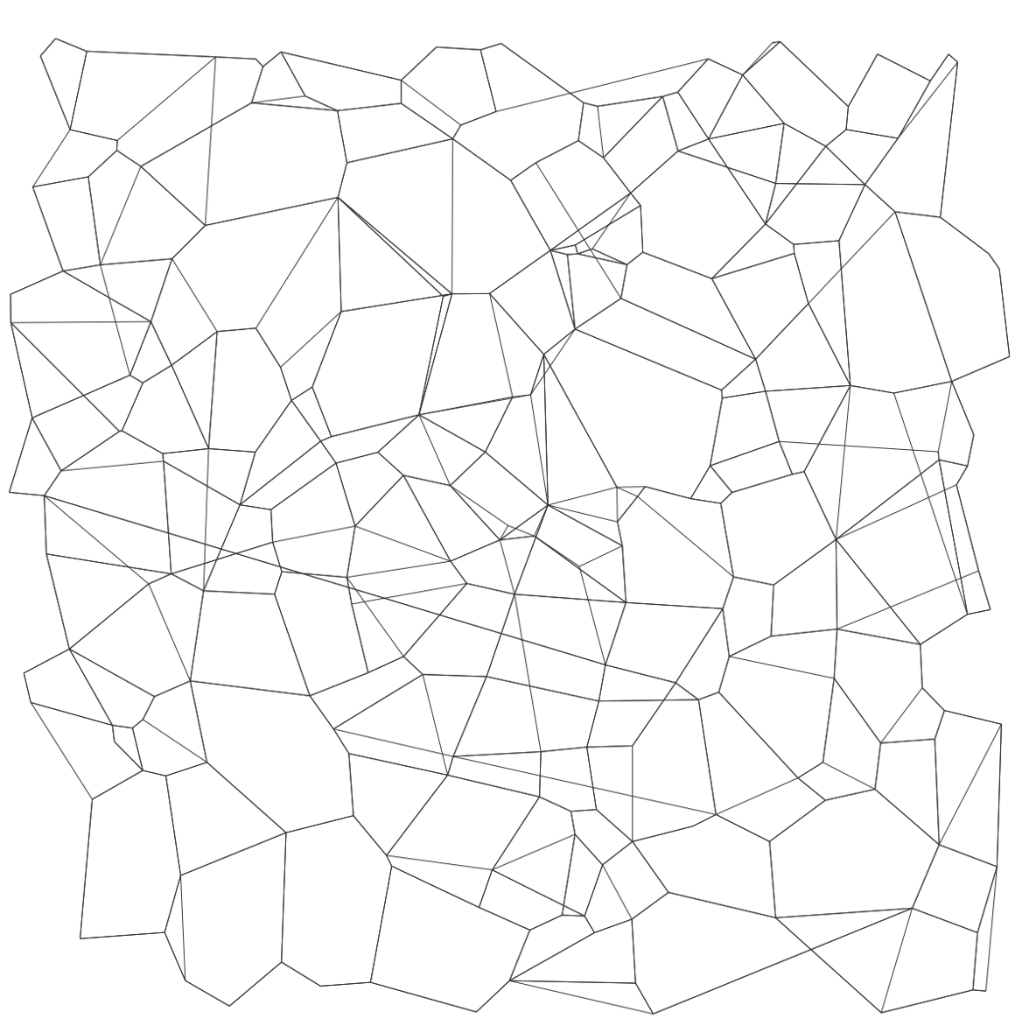
Track 2: Baseline: DiskANN [https://github.com/microsoft/DiskANN/]
DiskANN Design
Compressed vectors
(50-60GB/billion vectors)
DRAM
Low-diameter graph
+full-precision vectors
SSD
s
GreedySearch(q)
Let p = start node r
Fetch neighbors of p from SSD
Use compressed representation of points to decide which neighbor to move to!
q
Notes:
The baseline in this case is the DiskANN algorithm which is a hybrid DRAM-SSD system built on top of a graph-based index. The idea here is to construct a low-diameter navigable graph over the points in the index that is stored on the SSD. The full precision vectors are also stored on the SSD alongside the graph index. A compressed representation of the vectors, using the PQ method, is stored in memory.
As is the case with a graph-based ANNS index, the basic search proceeds via a greedy search algorithm.
To further accelerate the graph traversal, we cache the most frequently access nodes in the graph in the memory

Slide 11
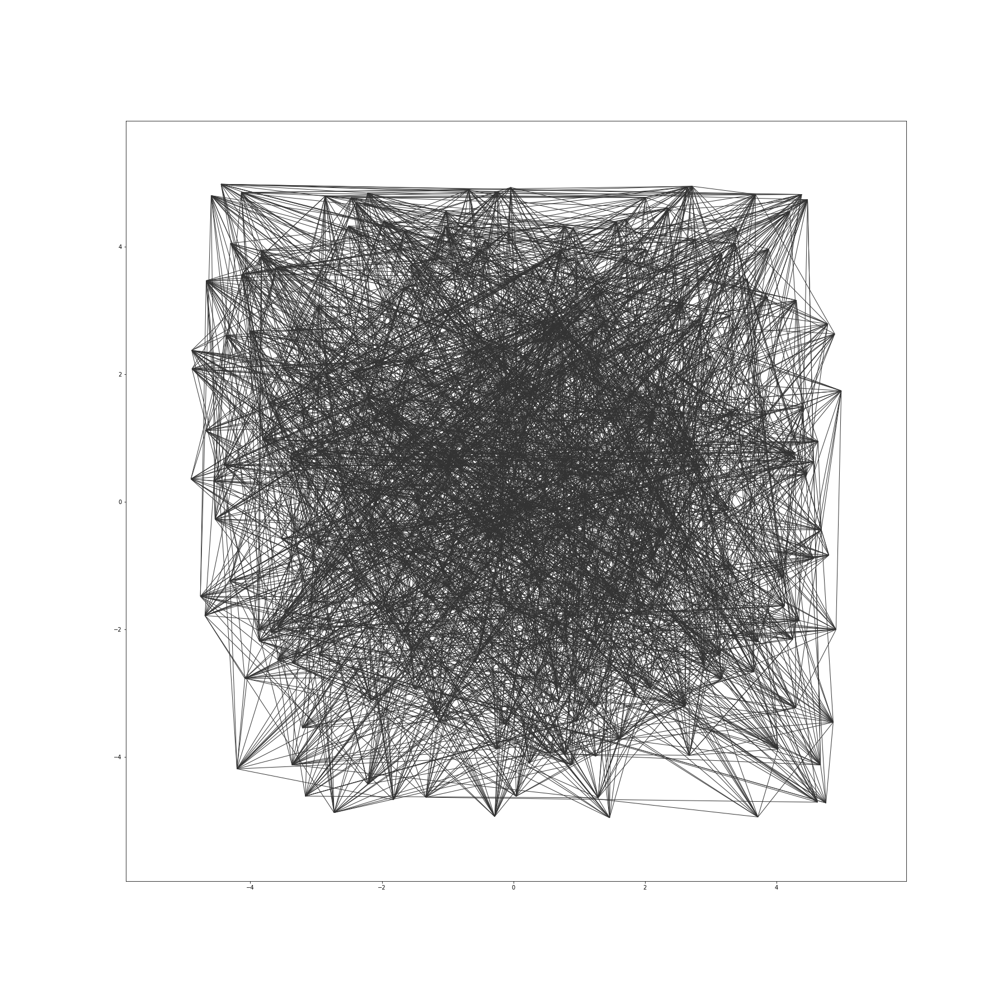
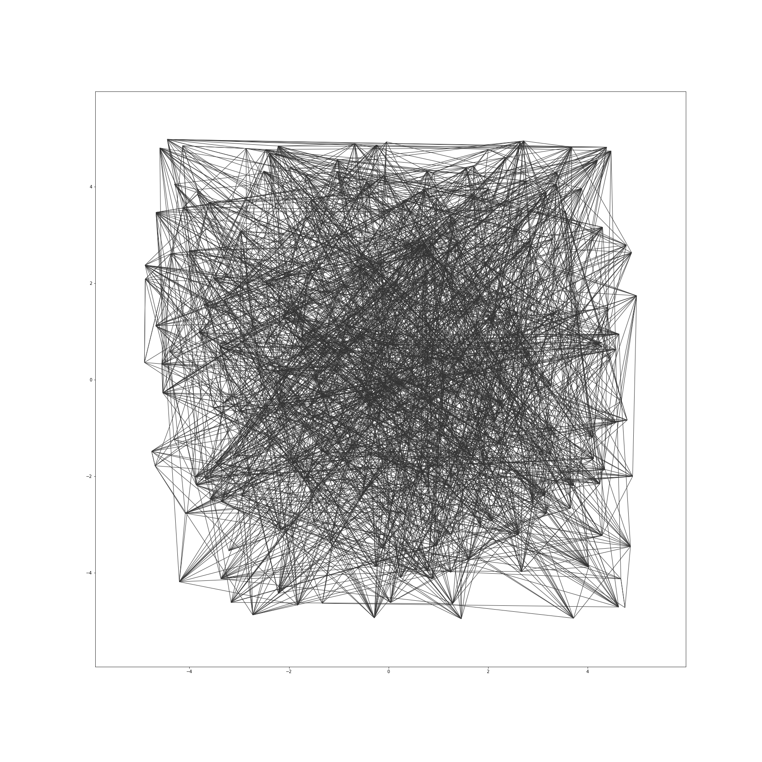
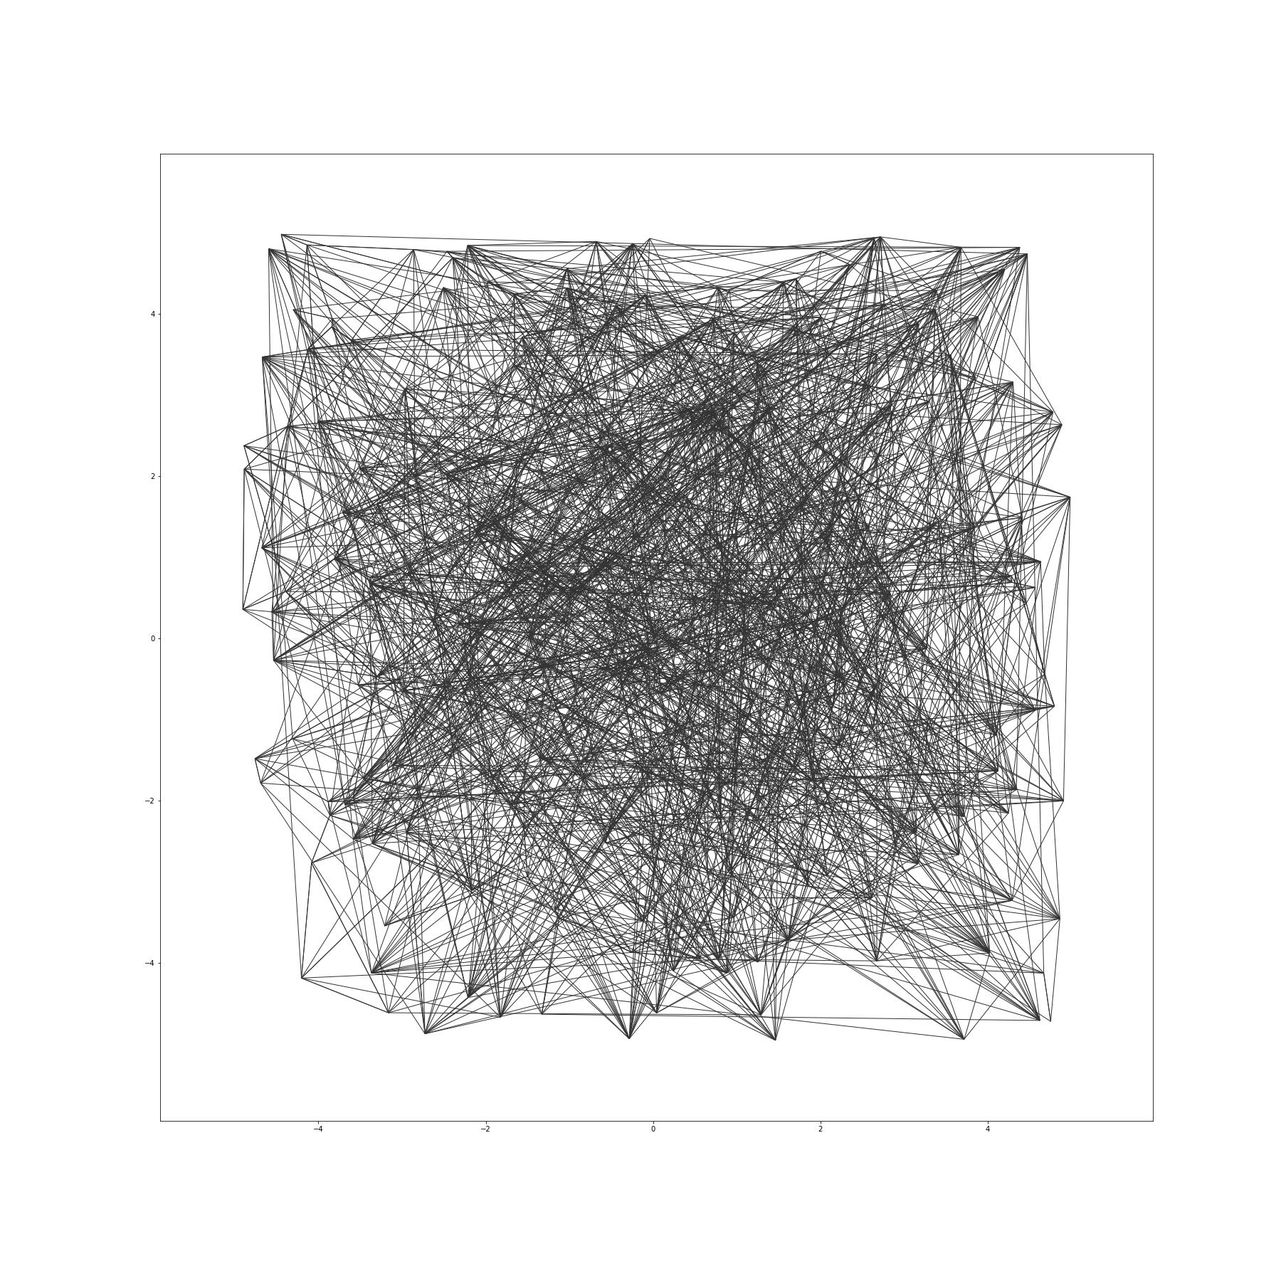
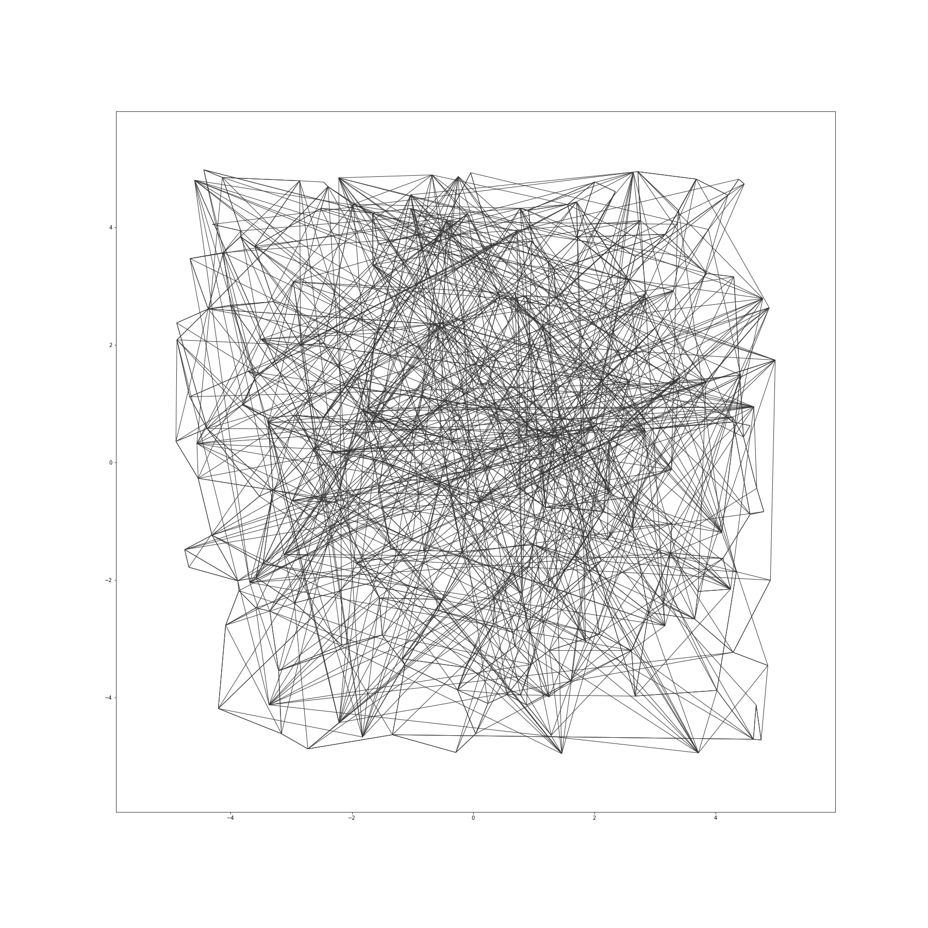
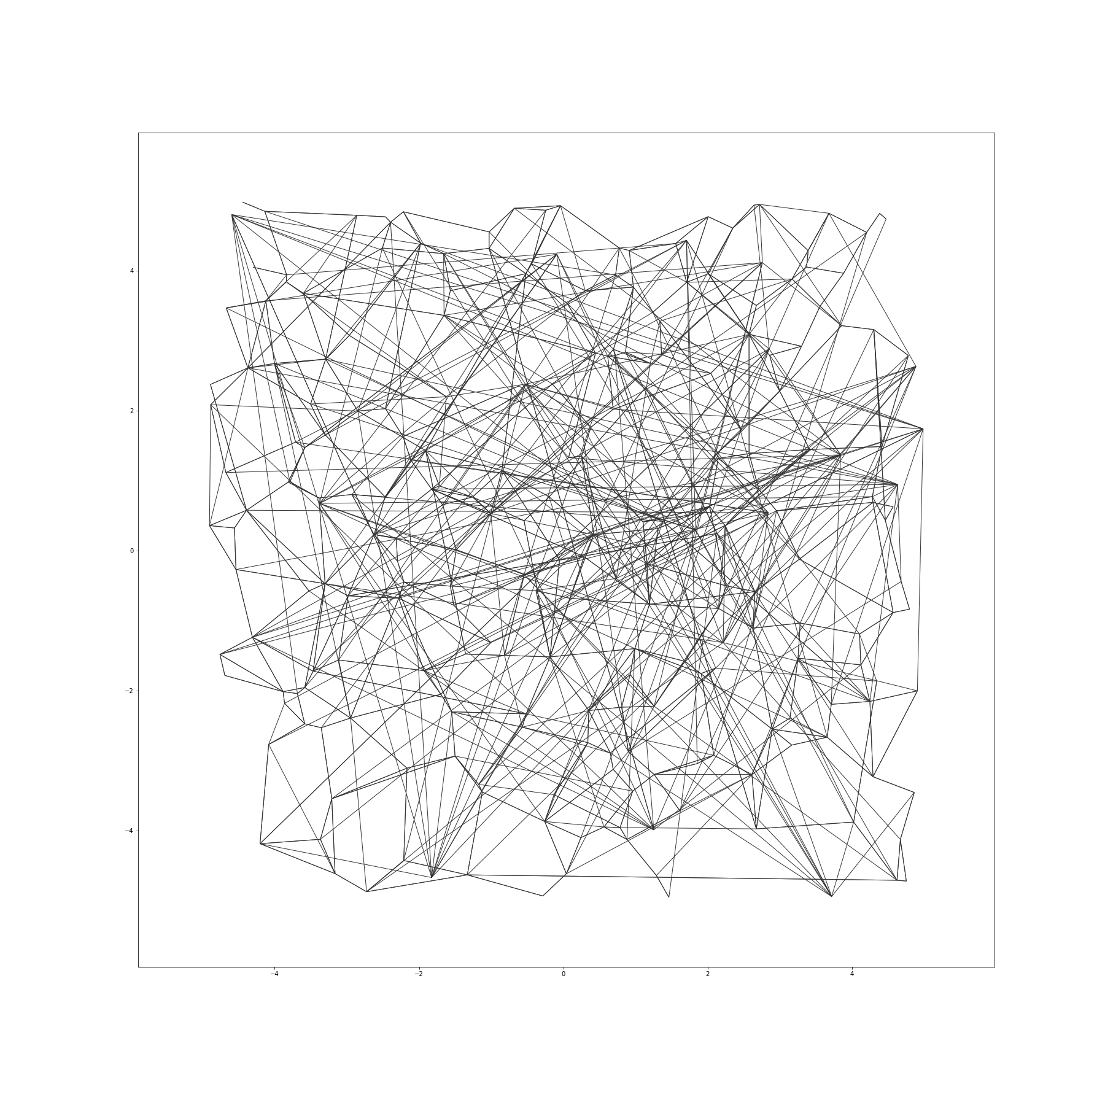
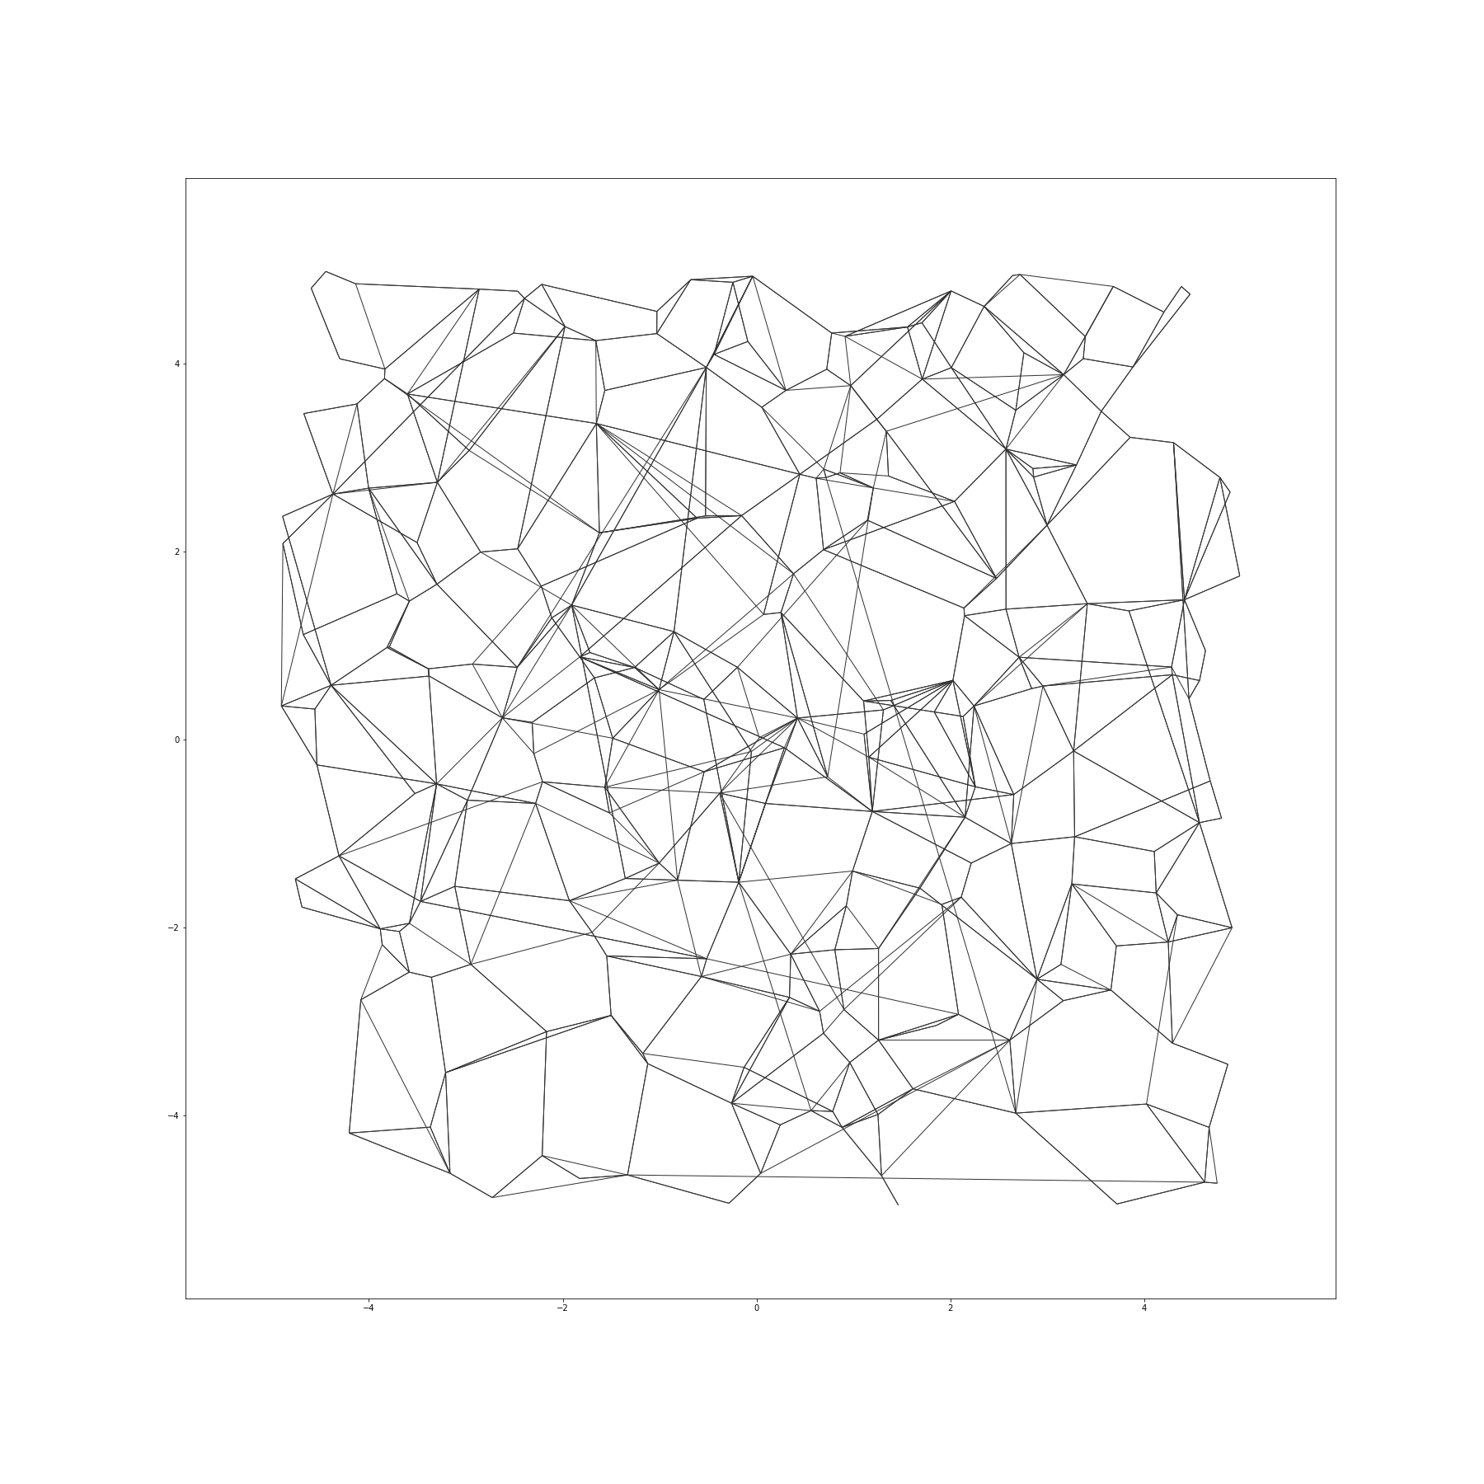
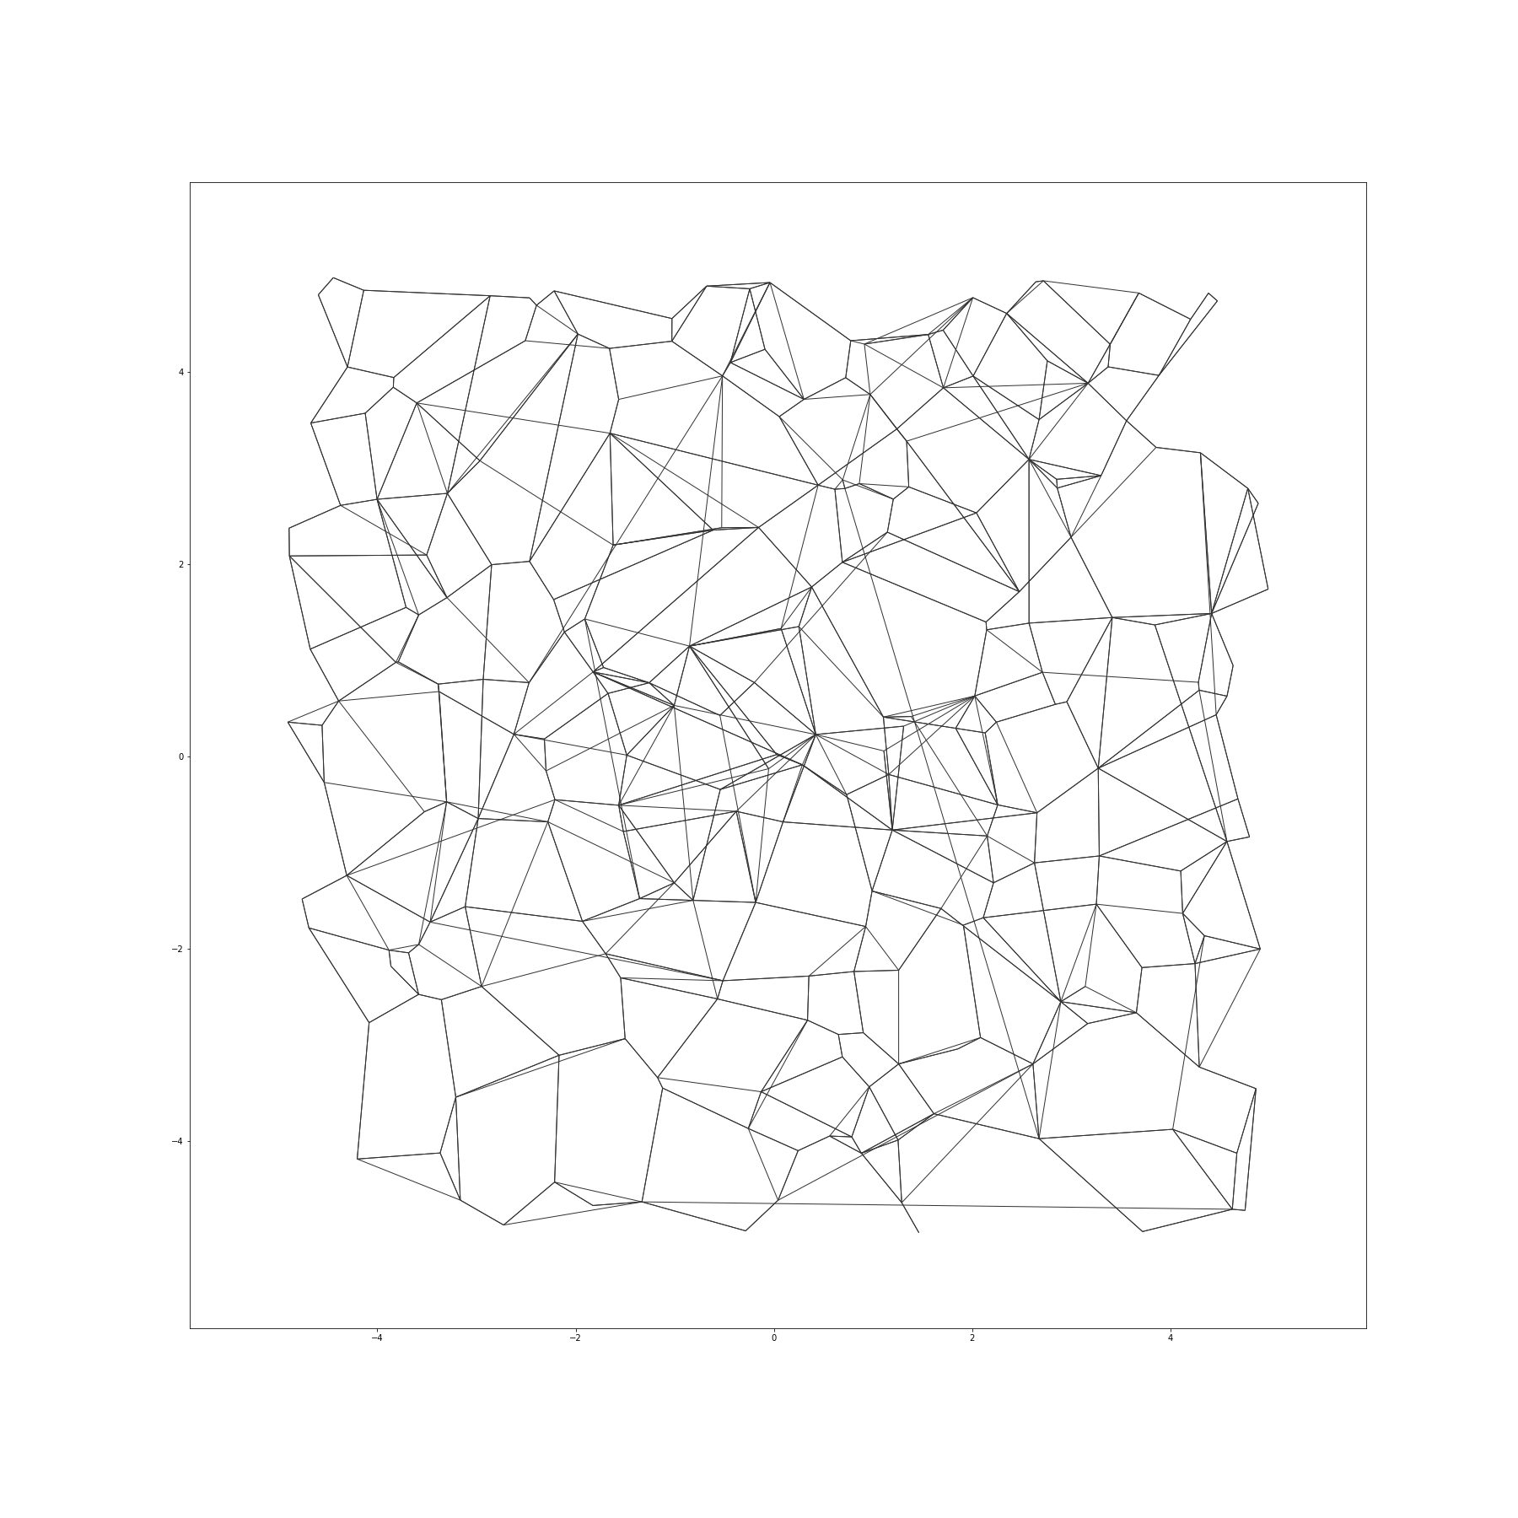
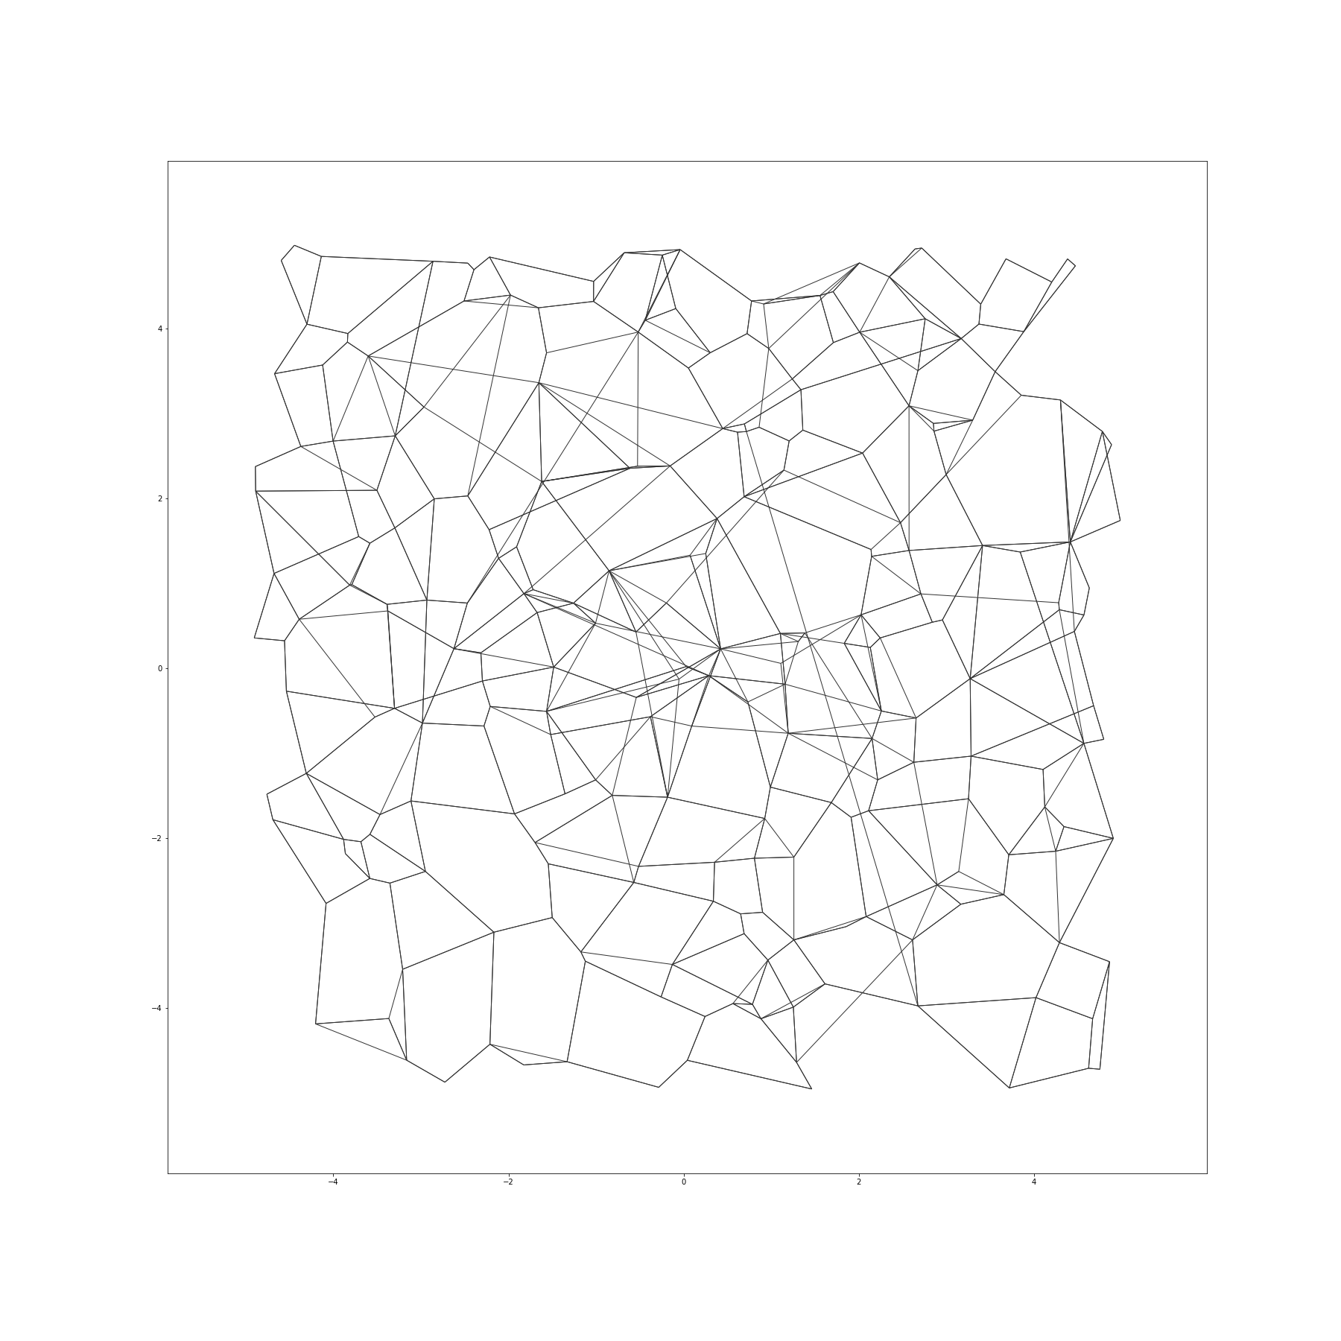
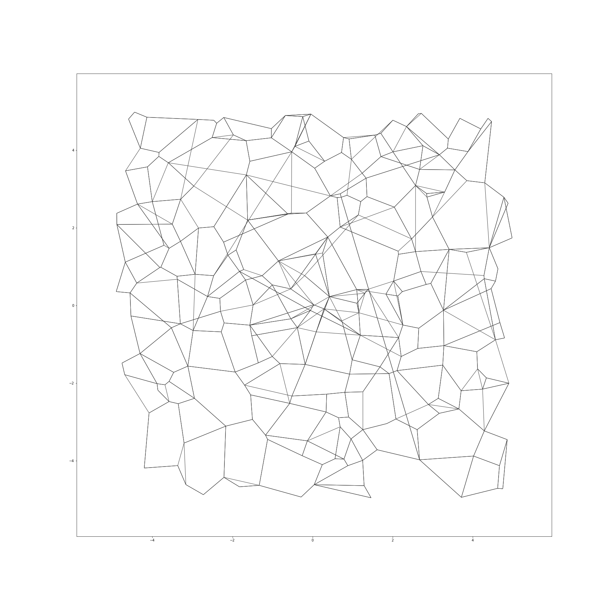
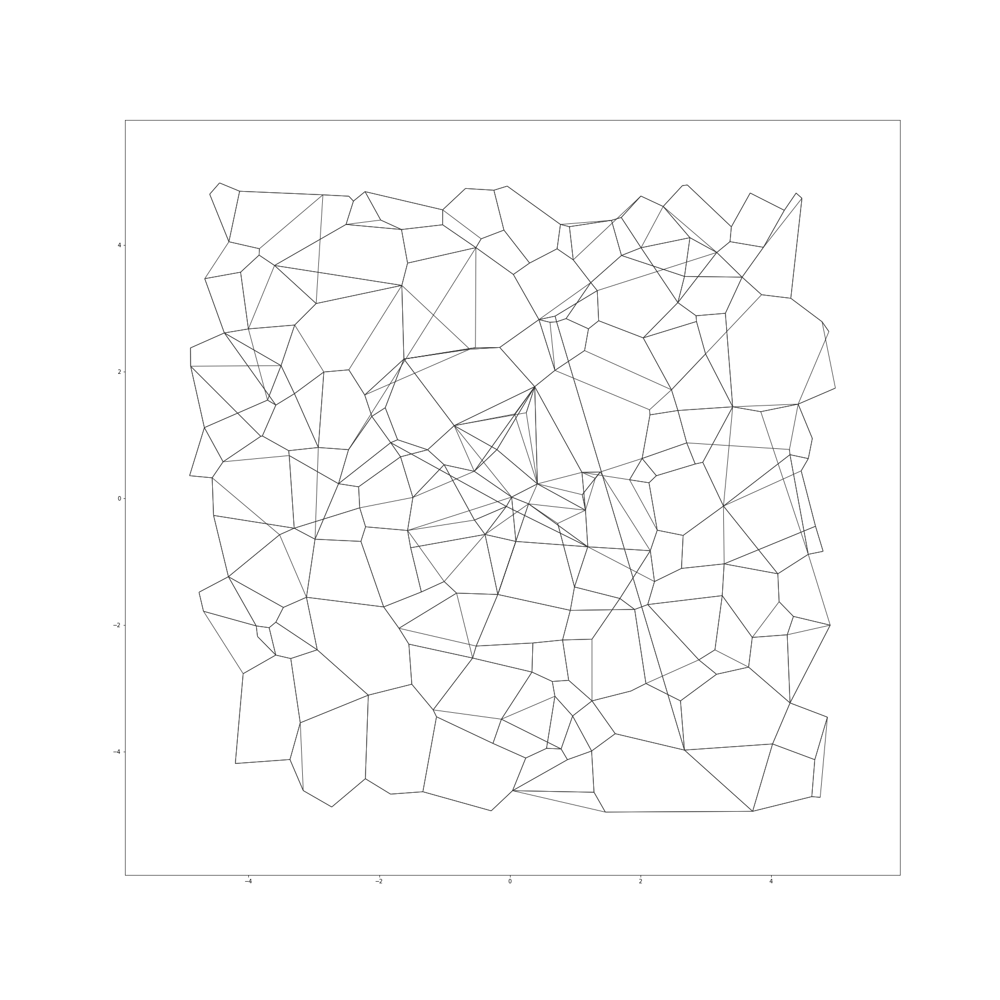
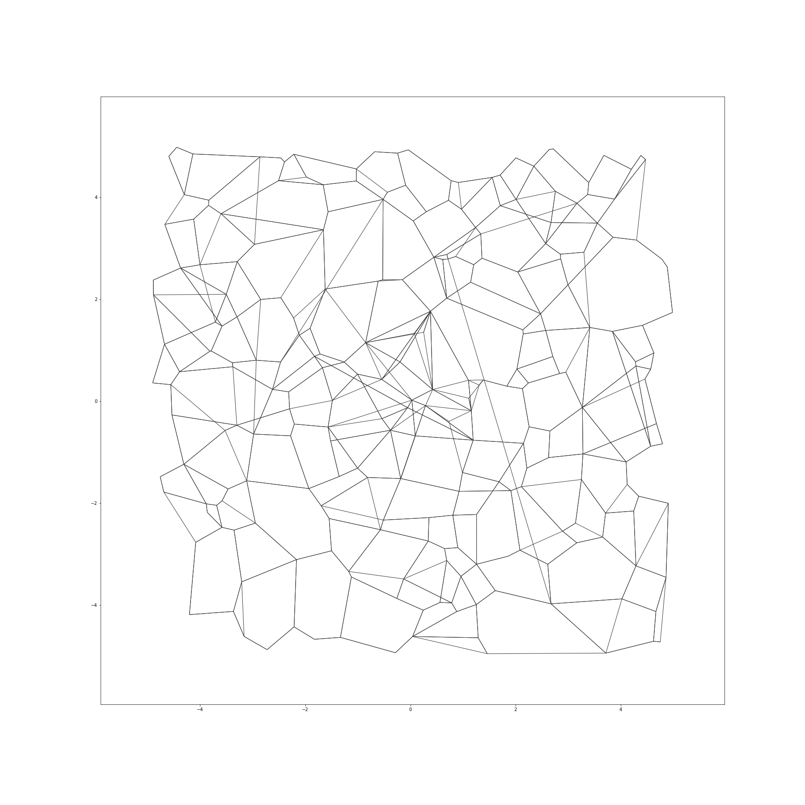
Illustration: DiskANN graph construction

Slide 12
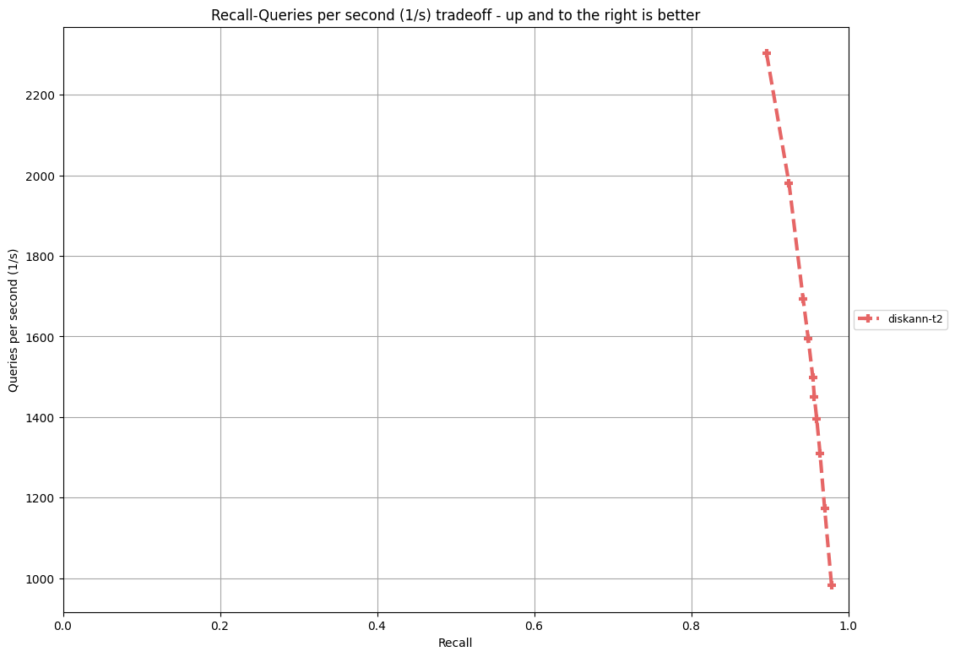
Track 2: Baseline DiskANN
Machine: Azure L8sv2
8 vCPUs, 64GB RAM, local NVMe SSD
Dataset | Recall @10 for >10K QPS
bigann-1B | 0.94913
deep-1B | 0.93706
msspacev-1B | 0.90095
msturing-1B | 0.93564
ssnpp-1B | 0.16274
text2image-1B | 0.48854
Queries/second
Recall@10 on bigann-1B
Recall asymptotes to 100%
Notes:
Akin to track 1, we plot QPS vs recall@10 on each dataset. In the plot here, we see the results for bigann-1B. We see that recall asymptotes to 100%. At the threshold of 1500QPS, we see that the recall@10 achiebed is 0.949. Similary, here is the table for the remaining dataset. As expected the cross-modal text2image1B remains hard.

Slide 13
Track 3: Any hardware. Baseline FAISS on V100 GPU
Use any hardware – bare metal, cloud or custom components/silicon
Better accelerators
Better memory technologies
Baseline: FAISS (IVF1048576,SQ8) on V100 GPU + 700GB DRAM
4 leaderboards
Recall improvements at 2K QPS
QPS improvement at config close to 90% recall
Power-normalized throughput at 90% recall
Cost-normalized throughput at 90% recall
Dataset | QPS | Recall@10
msturing-1B | 2011.542 | 0.910
bigann-1B | 2058.950 | 0.927
text2image-1B | 2120.635 | 0.860
deep-1B | 2002.490 | 0.942
msspacev-1B | 2190.829 | 0.850
Dataset | QPS | Recall@10
msturing-1B | 2421.856 | 0.902
bigann-1B | 2186.755 | 0.905
text2image-1B | 1510.624 | 0.882
deep-1B | 3422.473 | 0.916
msspacev-1B | 1484.217 | 0.869
Recall leaderboard
Throughput leaderboard
Notes:
Power measured using IPMI counters
Cost includes cost of hardware as well as cost of power over 5 year cycle.

Slide 14
Session Overview
Track results:
T1: 5 entries, T2: 3 entries, T3: 5 entries
Entries from industry research labs, universities and startups.
Two invited talks:
Alexandr Andoni, Assoc. Prof., Columbia University. http://www.cs.columbia.edu/~andoni/
Anshumali Srivastava, Assoc. Prof., Rice University. https://www.cs.rice.edu/~as143/
Presentation from winners of each track
Panel discussion on future directions
Evaluation framework (github.com) [open for more datasets, entries, and future problems]

